Slide 1


Metadata Evaluation Web Service ESIP 2018 Winter Meeting
Sean Gordon
Ted Habermann
January 9th

Slide 2
What is metadata evaluation?
v
Structured, sharable documentation e.g. XML, JSON
Turns data into information for humans
Communities use a standard dialect or create their own dialects to facilitate sharing their contributions to the field with others
Metadata
v
Community recommendations for documentation needs
What concepts exist in the collection of records?
Are the concepts in my metadata sufficient for other communities to understand the data?
Quantitative Evaluation
v
Qualitative Evaluation
Is the content of a concept consistent with other records in a collection?
Rules based analysis of the content of a concept
Notes:
Do the documentation concepts a community values to discover, access, use, and understand the data and related works exist in a record or collection?

Slide 3
Terminology
Collection:
A group of metadata records, commonly organized by a data center, organization or project and often stored in a database or web accessible folder.
Concept :
General term for describing a documentation entity (e.g. Title, Revision Date, Process Step, Spatial Extent).
Dialect :
A particular form of the documentation language that is specific to a community (e.g. DIF, CSDGM, EML, ECHO).
Recommendation:
A set of concepts that a group believes is required for achieving a documentation goal.
Profile:
A set of concepts required to support a particular documentation need or use case as part of a recommendation.

Slide 4
Conceptual Model
LTER uses the EML dialect (D₁) and created a recommendation with 5 levels (R₁, R₂, R_{3,} R₄, R₅)
A second community creates a dialect (D₂) with recommendations at two levels (R₇, R₈).
R₄
R₈
R₅
R₇
D₁
R₂
R₃
Common documentation needs exist, particularly for the discovery use case.
Four concepts from the Identification level (R₁) are EML schema required: Resource Title, Resource Identifier, Author, and Resource Contact.(R₆)
R₁
R₆
D₂
Discovery

Slide 5
Concepts are defined for each dialect
Recommendation elements
Recommendation concepts
A
B
C
D
E
A
B
C
D
E
Dialect definitions
Dialect definitions
A
B
C
D
E
A
D
E
EML Collection 1
EML Collection 2
CSDGM Collection 1
CSDGM Collection 2
A = 100% C=0% E = 50%
A = 66% C=0% E = 100%
A = 33% C=-100% E = 100%
A = 50% C=-100% E = 25%

Slide 6

Recommendations Analysis Dashboard
Concept |  | Recommendation Profile
Resource Identifier | 2% | DataCite3.1Mandatory
Resource Identifier Type | -100% | DataCite3.1Mandatory
Author / Originator | 100% | DataCite3.1Mandatory
Author / Originator Identifier | -100% | DataCite3.1Mandatory
Author / Originator Identifier Type | -100% | DataCite3.1Mandatory
Resource Title | 100% | DataCite3.1Mandatory
Publisher | 0% | DataCite3.1Mandatory
Resource Creation/Revision Date | 100% | DataCite3.1Mandatory
Keyword | 100% | DataCite3.1Recommended
Keyword Vocabulary | 100% | DataCite3.1Recommended
Contributor Name | 0% | DataCite3.1Recommended
Contributor Role | 0% | DataCite3.1Recommended
Responsible Party Identifier Type | -100% | DataCite3.1Recommended
Responsible Party Identifier | -100% | DataCite3.1Recommended
Resource Creation/Revision Date | 100% | DataCite3.1Recommended
Resource Type | 100% | DataCite3.1Recommended
Related Resource Identifier | 100% | DataCite3.1Recommended
Abstract | 100% | DataCite3.1Recommended
Spatial Extent | 75% | DataCite3.1Recommended
Incomplete use in the Collection | Unused in Collection | Missing from Dialect
Resource Identifier | Publisher | Resource Identifier Type
Spatial Extent | Contributor Name | Author / Originator Identifier
 | Contributor Role | Author / Originator Identifier Type
 | Transfer Size | Responsible Party Identifier Type
 |  | Responsible Party Identifier
Dialect Recommendation comparison
Signature score groups
Concept occurrence %
Guidance links

Slide 7
Dialect compared with a recommendation
Notes:
We can also use this to create coverage comparisons between dialects. This can be used to show the ability of a dialect beyond the discovery plateau and focuses the decision makers choice based on the shared scope of a dialect’s ability to contain the concepts needed for use and understanding information to be extracted from the data, not just the concepts needed for discovery and access.

Slide 8
Signature Score Groups
Low scores are good
Notes:
These results are presented as counts of records with identical completeness scores with respect to the recommendation. The completeness scores are given in terms of the number of elements that are missing from a record, so low scores are good.
When a recommendation includes multiple levels (e.g. Mandatory, Recommended, and Optional), the scores are given as a series of numbers, one for each level. These are termed signatures. Typically, many records are missing the same concepts and, therefore, have identical signatures.

Slide 9
Recommendation Concept Occurrence Percentage
Concept | Occurrence % | Recommendation Profile
Resource Identifier | 2% | DataCite3.1Mandatory
Resource Identifier Type | -100% | DataCite3.1Mandatory
Author / Originator | 100% | DataCite3.1Mandatory
Author / Originator Identifier | -100% | DataCite3.1Mandatory
Author / Originator Identifier Type | -100% | DataCite3.1Mandatory
Resource Title | 100% | DataCite3.1Mandatory
Publisher | 0% | DataCite3.1Mandatory
Resource Creation/Revision Date | 100% | DataCite3.1Mandatory
Keyword | 100% | DataCite3.1Recommended
Keyword Vocabulary | 100% | DataCite3.1Recommended
Contributor Name | 0% | DataCite3.1Recommended
Contributor Role | 0% | DataCite3.1Recommended
Responsible Party Identifier Type | -100% | DataCite3.1Recommended
Responsible Party Identifier | -100% | DataCite3.1Recommended
Resource Creation/Revision Date | 100% | DataCite3.1Recommended
Resource Type | 100% | DataCite3.1Recommended
Related Resource Identifier | 100% | DataCite3.1Recommended
Abstract | 100% | DataCite3.1Recommended
Spatial Extent | 75% | DataCite3.1Recommended
-100% = Concept Not in Dialect
0% = Concept Not in Collection
100% = Concept in All Records
A% = Concept in Some Records
Notes:
The visualization is comprised of rows for each recommendation concept and columns for each dialect. Cells are filled with a color or a percentage. The percentage is how many records in the sample set contain that concept.
Green represents 100%. Yellow represents 0%, a concept that the dialect contains but is not in any record in the sample set for that dialect. Red represents a concept missing from the dialect. The table is intended to show not only how complete a dialect is for a recommendation, as well as how complete the records are with respect to the dialect maxima.

Slide 10
Improvement Guidance Links
DataCite 3.1 Recommendation
Incomplete use in the Collection | Unused in Collection | Missing from Dialect
Resource Identifier | Publisher | Resource Identifier Type
Spatial Extent | Contributor Name | Author / Originator Identifier
 | Contributor Role | Author / Originator Identifier Type
 | Transfer Size | Responsible Party Identifier Type
 |  | Responsible Party Identifier
Link to background on the recommendation including links to the schema and surrounding documents the conceptual recommendation was built from.
Guidance links that explain what the concepts are and how they are defined for many dialects.

Slide 11
How can data managers ensure constant improvement?
Collection Completeness
Notes:
Premise
The LTER Completeness Recommendation includes documentation concepts the LTER community considers important for creating quality metadata. Ideally the completeness of LTER metadata would improve over time. The graph below illustrates how metadata collections evolve towards completeness. The model output improves 50% of 1000 records by one concept each time step. The visualization displays every fourth time step to simulate a 6 month period of collection development.

Slide 12
Compare between dialects for a particular recommendation
Sometimes new documentation needs compel repository managers to reevaluate their dialect of choice.
Direct comparison of dialects with community recommendations can help make that decision.

Slide 13
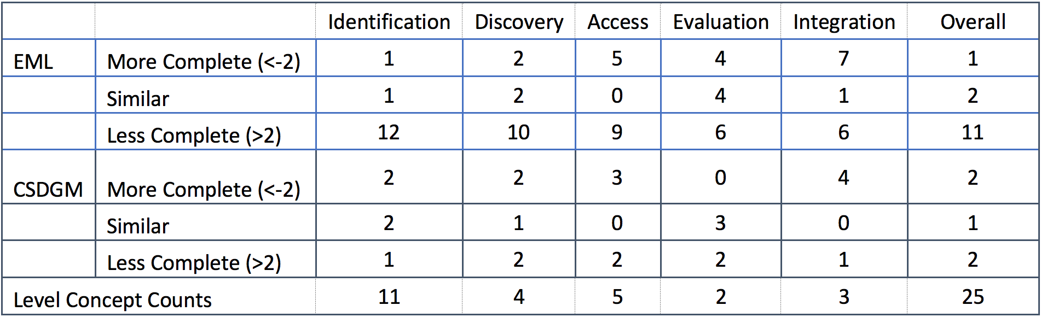
Comparing the recommendation’s originator with other collections
Using LTER as the baseline, compare other DataONE member nodes’ completeness
Use collections of any documentation dialect

Slide 14
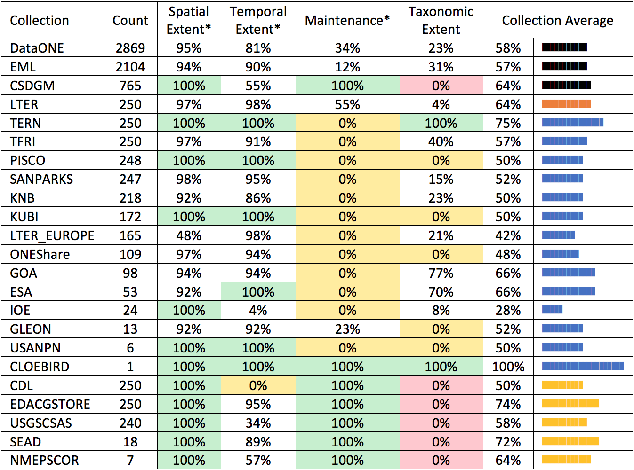
Compare between dialects for a particular recommendation
Compare completeness of a community recommendation for collections in a repository.
Able to make direct comparisons between collections written in different documentation dialects.

Slide 15
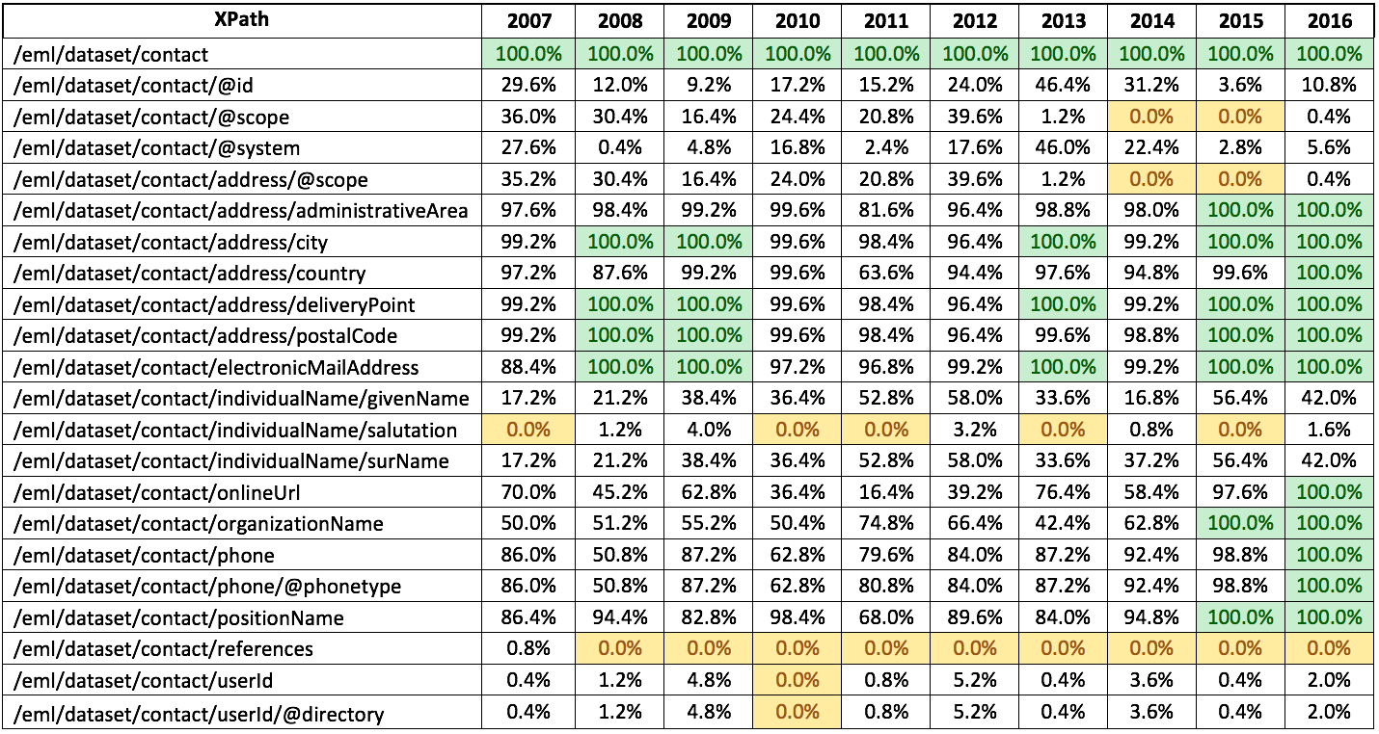
Element usage over time: evolution of a collection
Compare element or concept usage over time for a collection or organization.
Able to make direct comparisons between collections at different point in the improvement process.

Slide 16
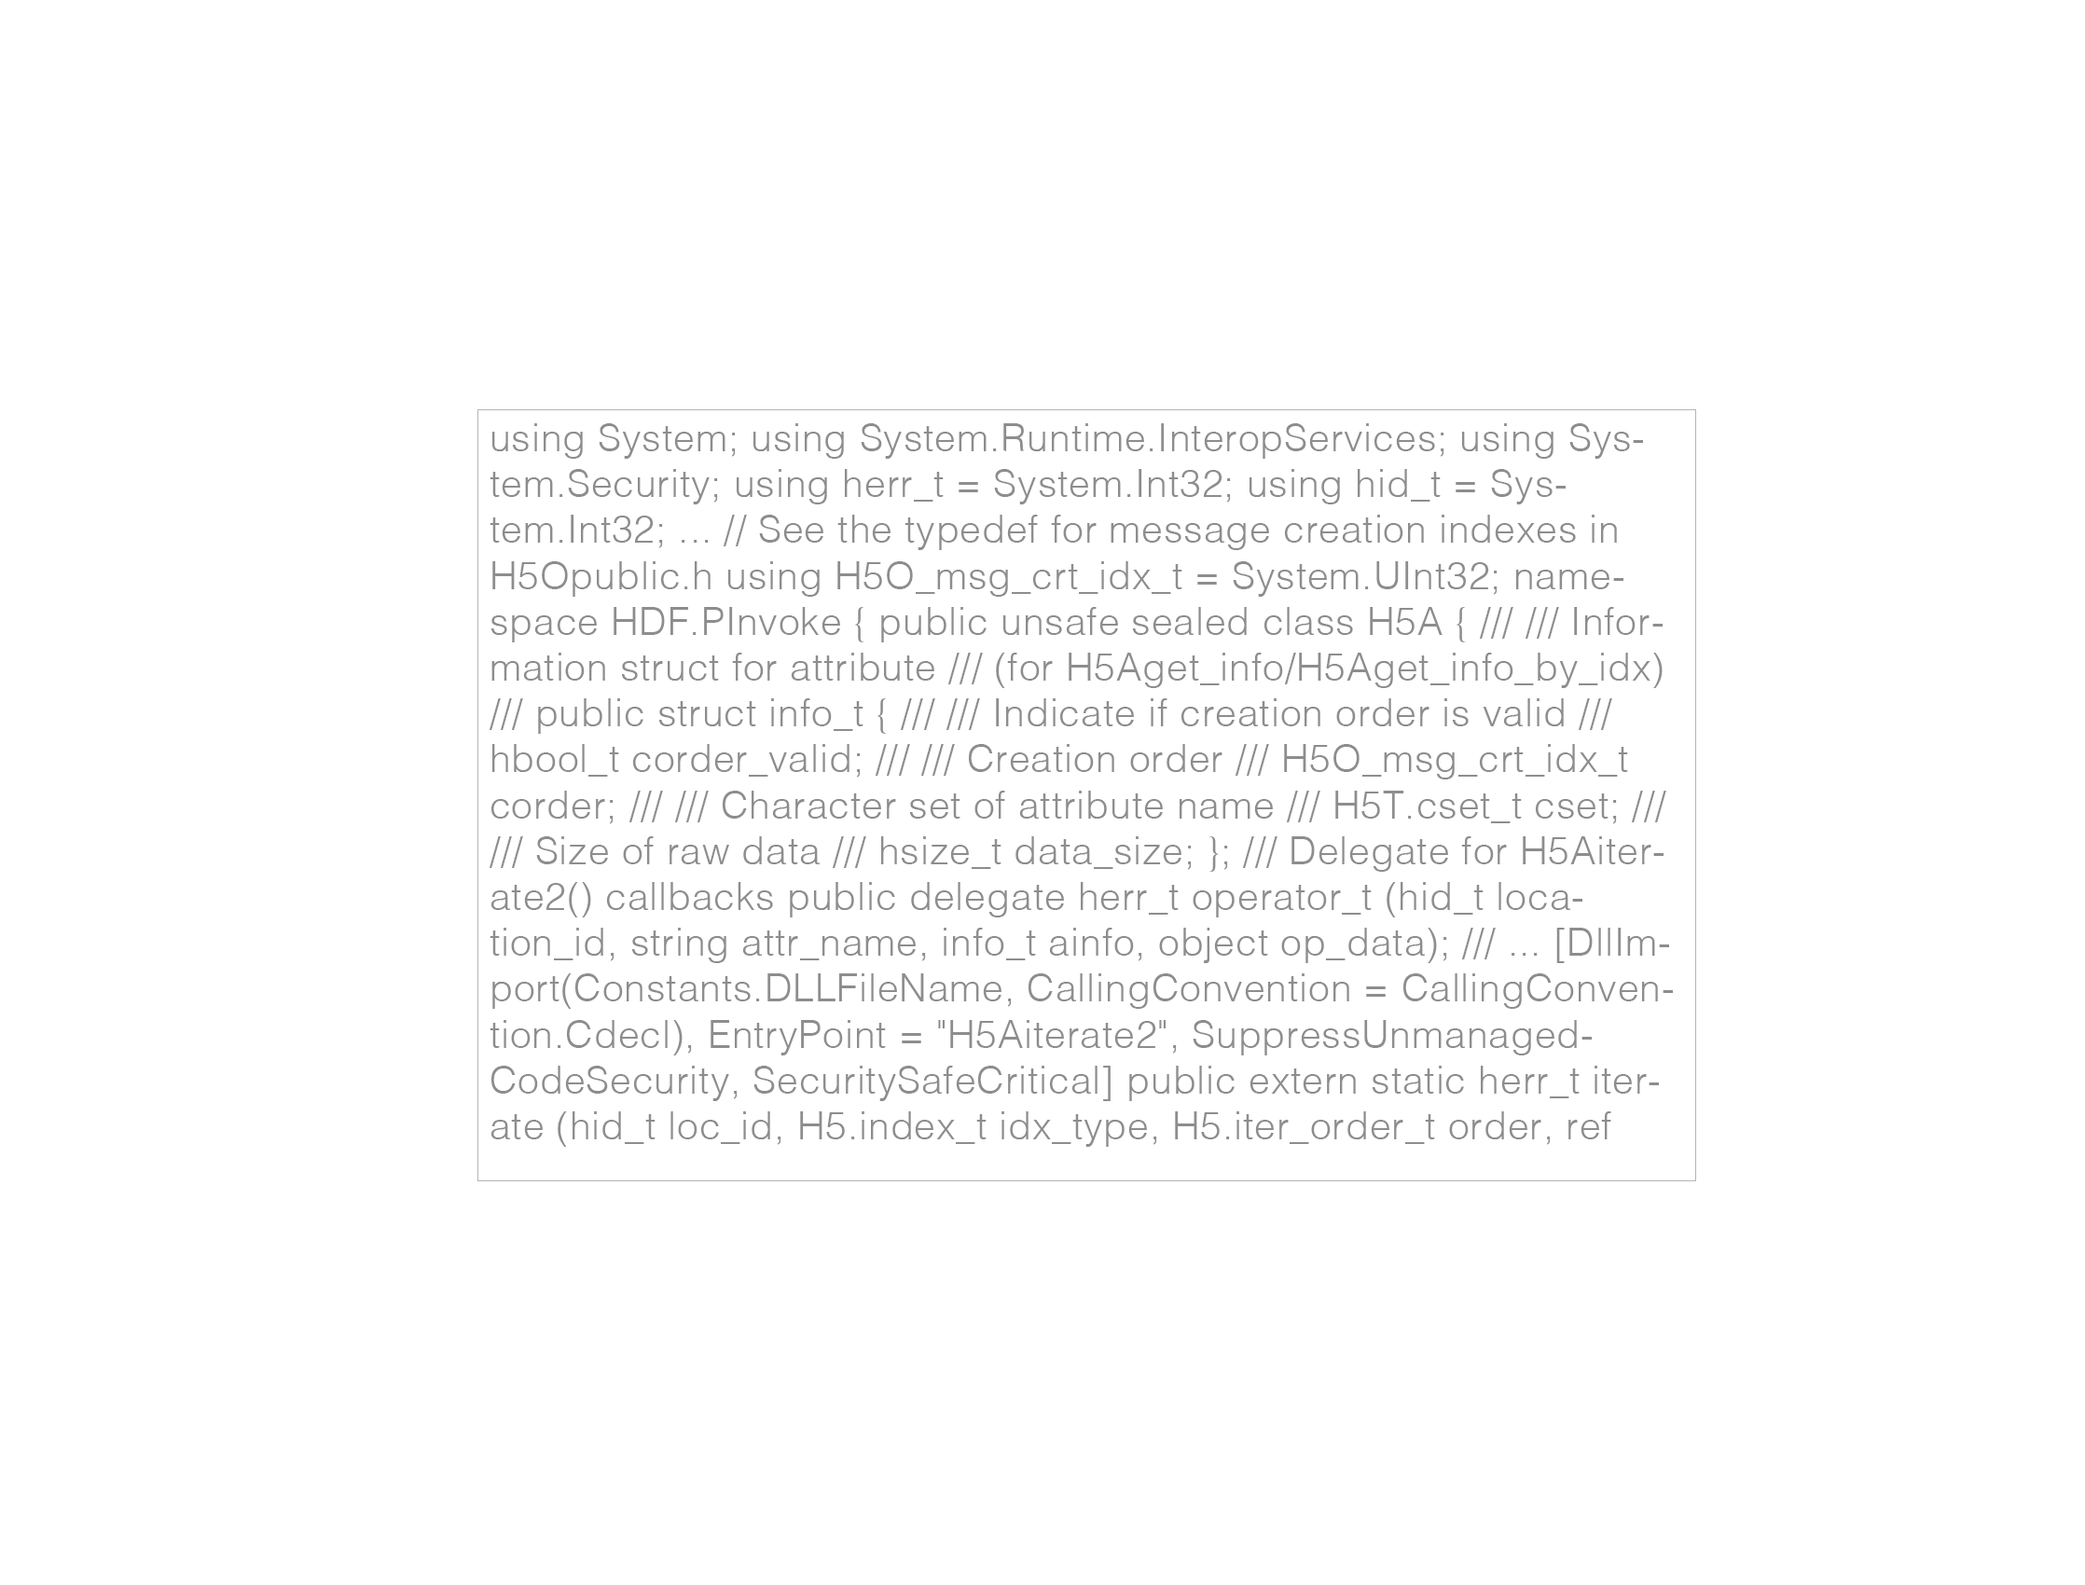
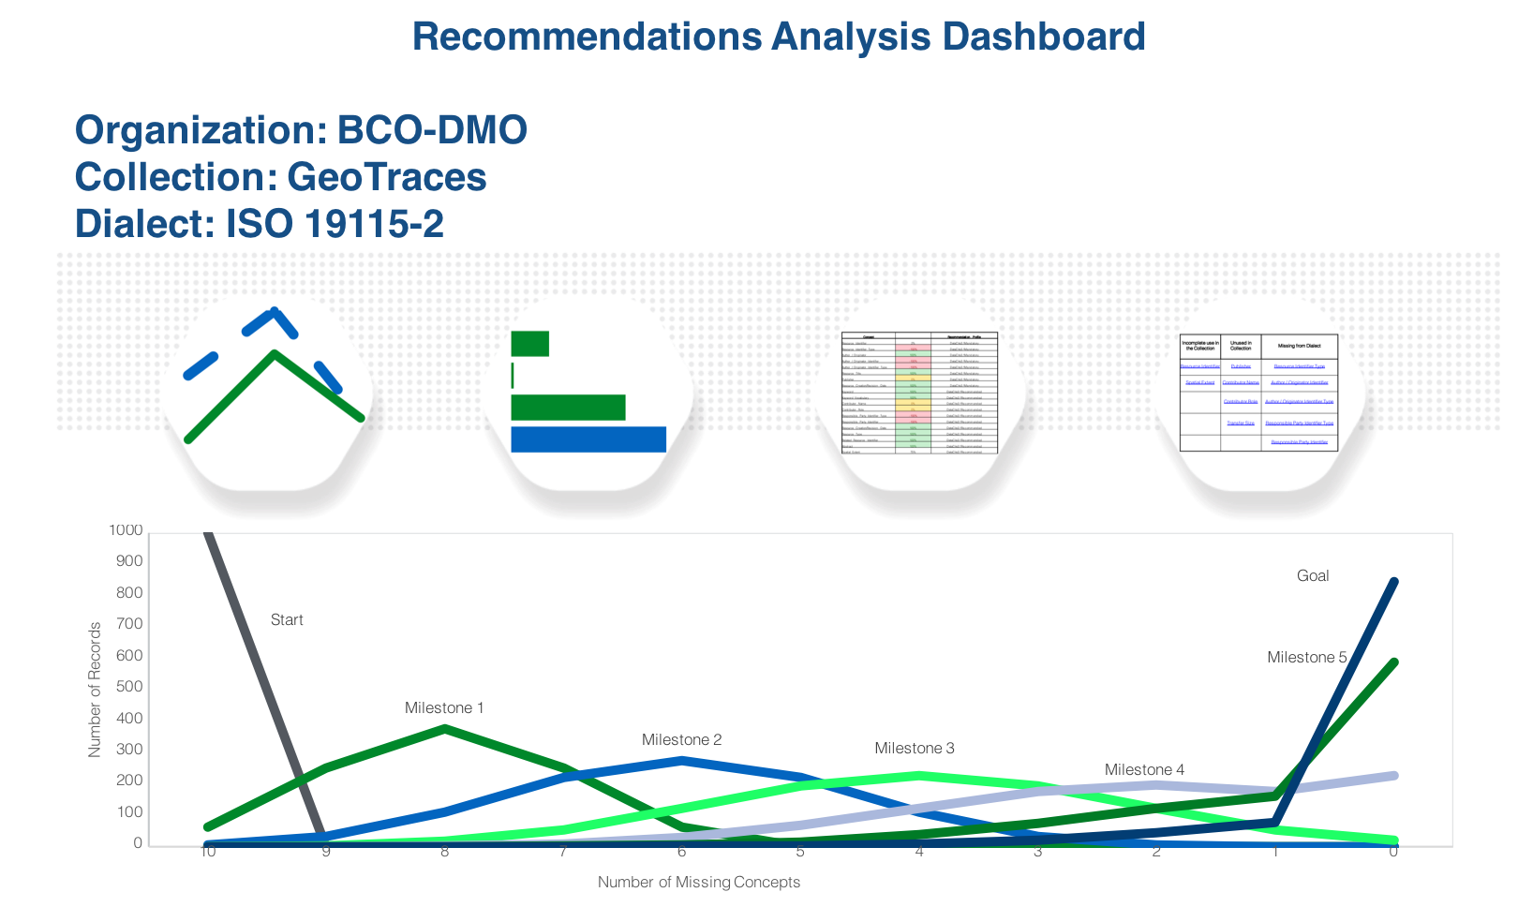
How can I evaluate my metadata?
Consultancy model to facilitate milestones and receive individualized improvement guidance
Metadata Evaluation Web Service
Metadata Evaluation Web Service!

Slide 17
What’s under the hood?
Jupyter Notebooks are used to prepare the XML collection for analysis
Python handles the transfer of the collection and the results
XSL transforms the collection into a raw data product
Pandas is used to create multiple data products

Slide 18

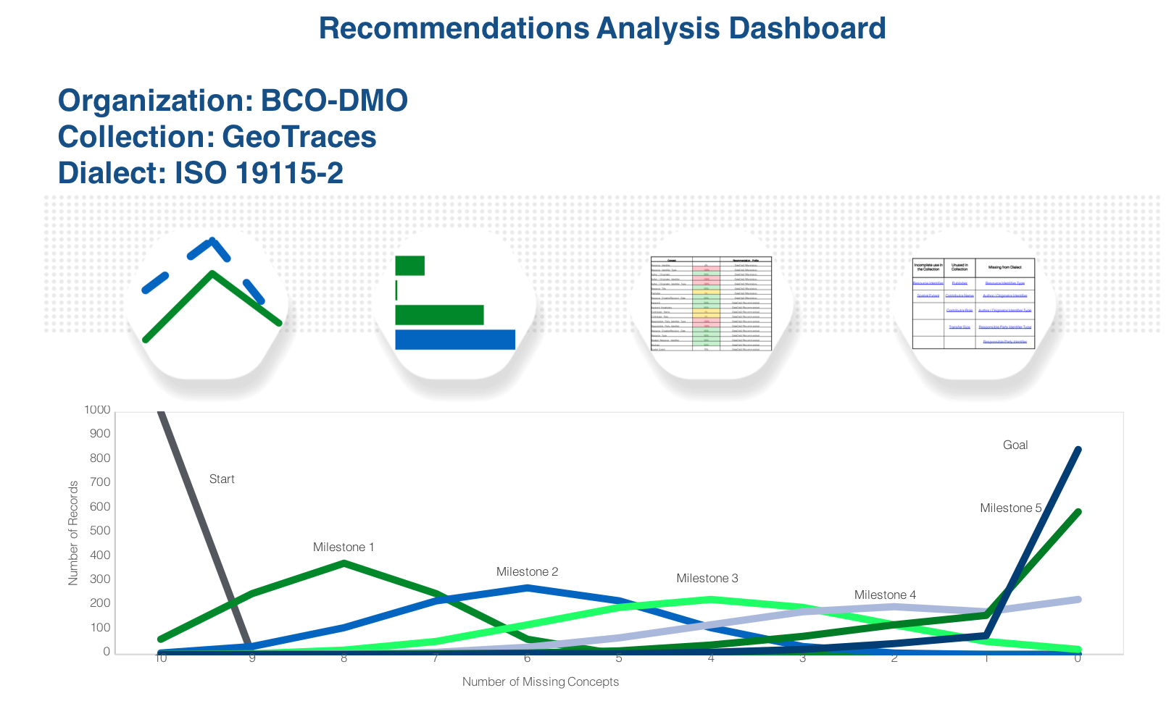

How does it work?
Metadata Evaluation Web Service
XML collection
XML collection
Compressed
Transfer
MetadataEvaluation
User initiated Metadata Evaluation Web service workflow

Slide 19
Questions?
scgordon@hdfgroup.org
github.com/scgordon
https://doi.org/10.1016/j.ecoinf.2017.09.005

